Slide 1

Becoming A Data Scientist
“Discover what it means to work with data”

Slide 2
Introduction
What Is A Data Scientist??
Notes:
Rob: Does anyone have an answer?

Slide 3
What is a Data Scientist
Someone who is a self-motivated and enthusiastic learner with quantitative and computational skills.
Someone who can complete individual tasks involving data exploration and can also contribute in a collaborative work environment.
Someone who is not afraid to set and meet challenges which are essential for the betterment of a company or organization.
The ultimate goal of a data scientist is to take raw information in the form of data, and to be able to convey the underlying story which the data tells.
Notes:
Rob: Read it out.

Slide 4
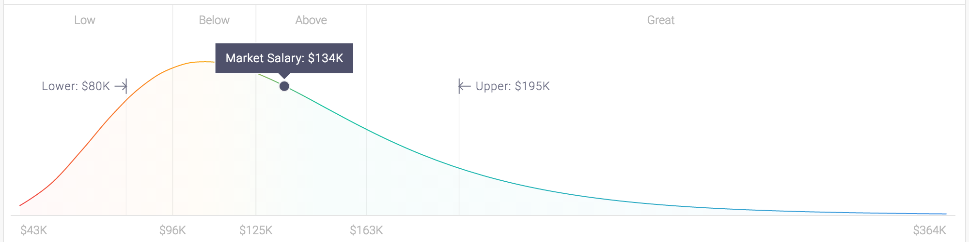
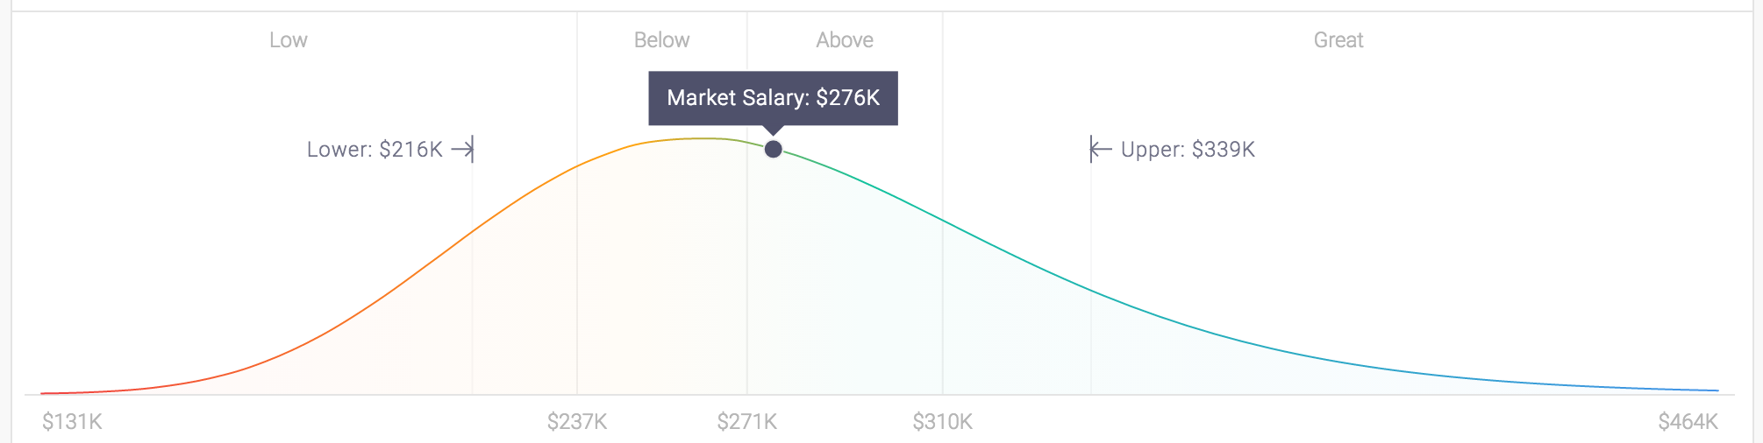
Why Become A Data Scientist
https://www.quora.com/What-is-the-salary-of-a-data-scientist

Slide 5






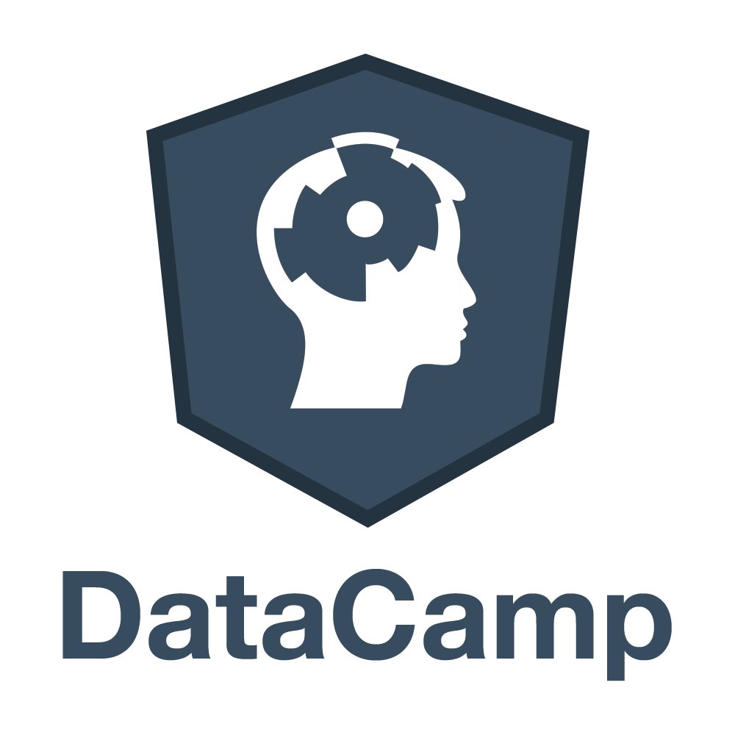






Industries That Hire Data Scientists
Notes:
Rob

Slide 6
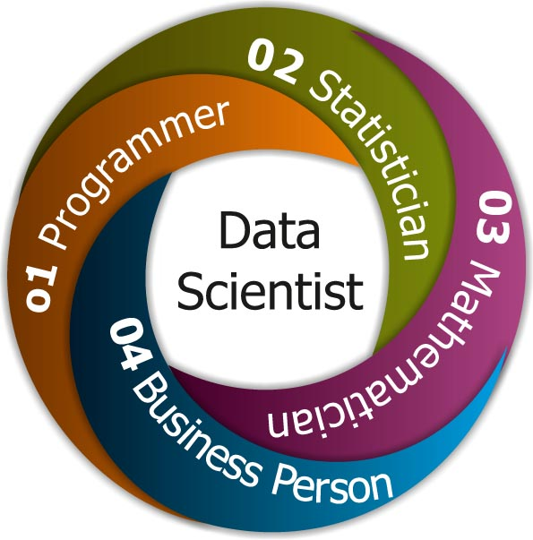
Data Science Jobs In the Industry
Data Scientist
Data Analyst
Database Engineer
Statistician
Business Analyst
Sports Analyst
Risk Analyst
Biostatistician / Bioinformatics
Health Informatics
Social Scientist
https://techinfographics.com/wp-content/uploads/2016/02/Data-Scientist.jpg
Notes:
Rob: Differentiate between the top 3

Slide 7
What Is Big Data?
Definition for Big Data:
The processing of large and complex data
Defined by the properties of volume, variety, velocity, and veracity
IOT (Internet of Things) - micromachines that collect data
The benefits to using Big Data:
Being able to store large quantities of data
Having the data to perform accurate analysis & predictive analytics
Increased performance while being able to look at real-time analytics
There are many challenges to using Big Data:
The technology to run petabytes of data
The decision making, cost, and security to having big data
The need to create team of Data Scientists and technicians to manage big data
Notes:
Vincent:
My definition of big data; you can go into its impacts or the technology that runs big data
Volume = size, variety = type, velocity = speed and growth, there is also variability = inconsistency, veracity = quality/truth
Smartphones, smart devices, or rfids

Slide 8
What Questions Need to be Answered with Data?
Depending on the goals of the firm, or the industry you work in, the first step in approaching a problem is knowing what question needs to be answered.
Some questions may be more difficult to answer than others, but by understanding the question it helps us determine what data needs to be collected. (examples include: What production processes are effective or ineffective? What is our firm’s return on marketing? How effective is a drug in preventing symptoms? Does gender or race discrimination exist in the workplace?)
Sometimes preexisting data is all you need, other times a data scientist has to conduct experiments or collect observational data to meet his or her project needs.
Notes:
Vincent

Slide 9
Collecting Data
When collecting data there are two types that you should keep in mind:
Observational Data - Is the inference of a sample or a group where the data scientist does not control the events of the study. The experimenter observes the variable of interest to model a conclusion or formulate his hypothesis.
Experimental Data - In certain cases, it is useful for a data scientist to perform an organized study which randomly divides subjects into groups to control variability in the data. The experimenter then manipulates the variable of interest and assigns different test values to each group in order to study its effect on an outcome.
https://www.washingtonpost.com/news/wonk/wp/2017/02/28/researchers-confirm-that-yolo-is-sound-life-advice/?utm_term=.843db64b53f5
Notes:
Vincent: Population vs Sample?

Slide 10
Collecting Data
A data scientist searches for data which may be hypothesized to have an affect on some outcome of interest. Data can be both quantitative or categorical. Some examples include:
Quantitative Data - Sales or cost data, production speed, marketing effectiveness, drug effectiveness, disease outbreak, calorie consumption, age, etc.
Categorical Data - Geographic location, sales platform, machine type, wording of advertisement, gender or race, blood type, food group, etc.
The key is to collect relevant data to meet your objectives. This is, however, up for interpretation, and a data scientist is encouraged to be adventurous. You never know where you might find “relevant data”.
Notes:
Vincent

Slide 11
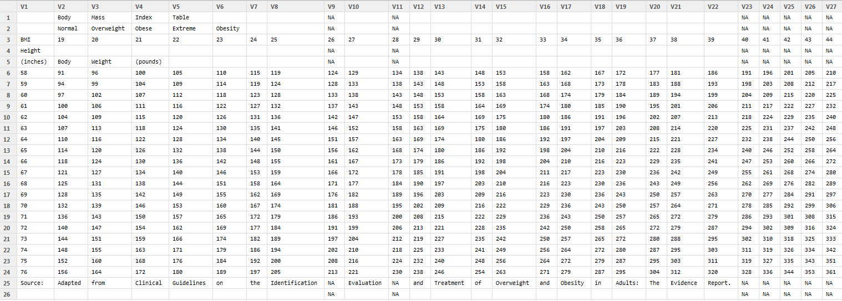
Cleaning Your Data
https://losetposet.files.wordpress.com/2013/11/table.png
Notes:
Vincent: Data is not always clean… There are many different ways to clean a dataset.

Slide 12
Data Wrangling
The art of data manipulation; data wrangling is the ability to transform and organize raw data sets into something that you can work with. Some examples are:
Sorting
Filtering
Aggregating
Merging
Subsetting
Summarising
Notes:
Rob

Slide 13
Data Wrangling
How do we deal with missing values?
Identifying which NAs can be omitted and which need to be predicted
Imputation
Prediction algorithms
How to obtain more information from our datasets?
Joining different datasets together
Discovering new-layers of information
Rearranging your data to tell a different story
How can we transform data?
Data Type Conversions
Mathematical Transformation
Notes:
Rob

Slide 14
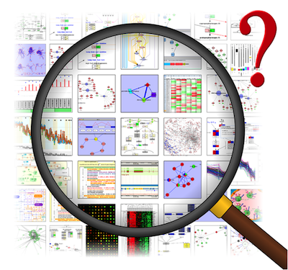
Data Exploration
http://3.bp.blogspot.com/-UdFMnZJ6NL0/T2j2qIDUqeI/AAAAAAAADi4/9vIWJKtgv-o/s400/journal.pbio.1000472.g001.png
Notes:
Rob: Where do we start...

Slide 15
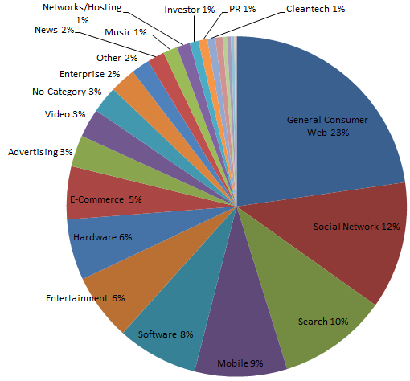
Data Visualization
https://static1.squarespace.com/static/55b6a6dce4b089e11621d3ed/55b6d08fe4b0d8b921b02f83/55b6d0b6e4b0d8b921b03a36/1438044342911/1000w/
Notes:
Rob: Why this is bad.

Slide 16
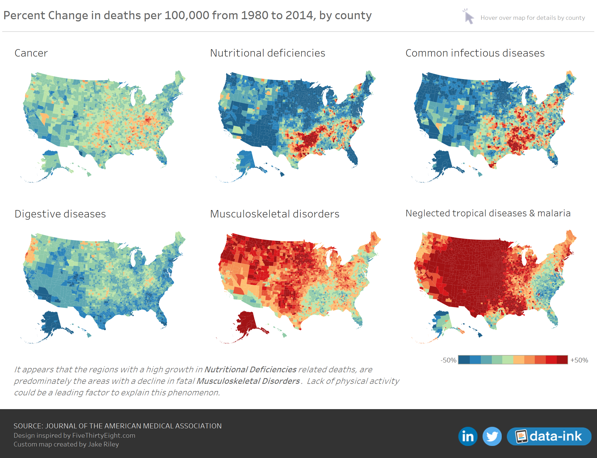
Data Visualization
Notes:
Rob: Why this is good.

Slide 17
Publishing Your Work
When becoming a Data Scientist the most important way to standout is to publish your work. It is requirement for any researcher or aspiring Data Scientist to learn how to communicate their findings to an audience.
Academic Papers
Blogs & Articles
Rpubs
Kaggle
Tableau
Notes:
Vincent: When you go out into the industry, no matter how smart you are. If you cannot interpret your findings into something that your boss or others can understand, you’re out of a job.

Slide 18








Programming Languages
Notes:
Vincent: Look at it.

Slide 19
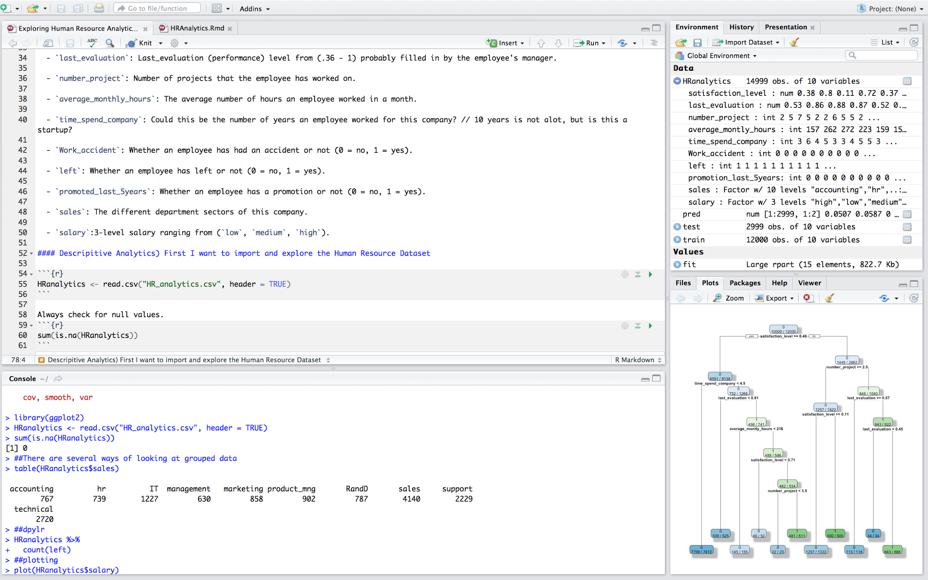
Working With R and R Studio
Notes:
Vincent: This is a typical work environment

Slide 20
Conclusion
“ To have an eye for opportunity is to be a Data Scientist. ”
- Damian Mingle
Notes:
Vincent:

Slide 21
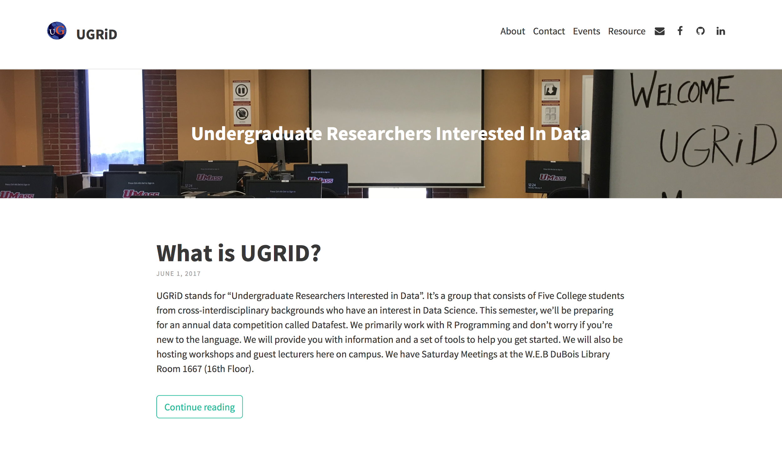
Notes:
Vincent:

Slide 22

Where to Find Us
UGRID Meetings are held weekly at the W.E.B Dubois Library on the 16th Floor from 2-5pm (don't be afraid to show up early and feel free to leave whenever).
Email: umassugrid@gmail.com (join our mailing list, everyone is welcome)
We are located
right here !!!
Notes:
Vincent: Who we are and where we’re located. Email us.

Slide 23
Data Events & Competition
There is a large community who dedicates themselves to working with data:
ASA Five College Datafest
UGRID Workshops
Online Kaggle Competitions
Massachusetts Digital Government Summit
Big Data Summit
Online Data Driven Competition
Notes:
Vincent: May not need this

Slide 24
What Can you Expect From Us
Starting your path to becoming a Data Scientist
Resources dedicated to help you get started with R programming
Work with teams who are looking at Real World Datasets
More workshop from guest speakers and professors
Meet and socialize with people who are interested in data
Establishing a Data Science Portfolio
Participate in Data Competitions and Events
Notes:
Vincent:

Slide 25

Next Workshop: Building A FREE Website Portfolio
In the next workshop, I will be teaching you how to build a static webpage using Jekyll which is the same technology that we use to build our website ugrid.info.
This will likely be scheduled on the Friday after Spring Break. For notifications join our mailing list by emailing to umassugrid@gmail.com.
Otherwise, you can try to look for flyers that will be posted around campus.
Notes:
Scratch that we have a Introduction to Tableau for ugrid members

